Slide 1

Chapter 1: Introduction
Gonzalo De La Torre Parra, Ph.D.
Fall 2021

Slide 2
Network Security Management
NSM is the collection, detection, and analysis of network security data. Information security has traditionally been divided into many different focus areas (Computer Network Defense [CND] per DoD 8500.2):
Protect: The protect domain focuses on securing systems to prevent exploitation and intrusion from occurring.
Detect: Detecting compromises that are actively occurring or have previously occurred. This includes network security monitoring and attack sense and warning.
Respond: Incident containment, network and host-based forensics, malware analysis, and incident reporting after a compromise has occurred.
Sustain. The final CND domain deals with the management of the people, processes, and technology associated with CND. This includes contracting, staffing and training, technology development and implementation, and support systems management.

Slide 3
Key NSM Terms
Asset
Threat
Vulnerability
Exploit
Risk
Anomaly: an observable occurrence in a system or network that is considered out of the ordinary. Anomalies generate alerts by detection tools such as an intrusion detection systems or log review applications.
Incident: An incident is a violation or imminent threat of violation of computer security policies, acceptable use policies, or standard security practices2. More simply stated, an incident means that something bad has happened, or is currently happening on your network.

Slide 4
What is Intrusion Detection?
It is a component of network security management
Characteristics
Vulnerability-Centric Defense: IDS is deployed with the goal of detecting the exploitation of vulnerabilities. Focuses on how the attacks take place.
Detection in Favor of Collection: Collecting data that is not tied to collection.
Mostly Signature-Based: relied on having knowledge of all known vulnerabilities and developing signatures for their detection.
Attempts to Fully Automate Analysis: Reduce the involvement by human analysts and attempt to automate post-detection analysis as much as possible.

Slide 5
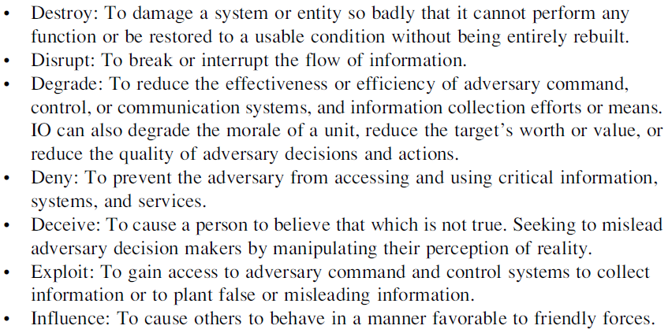
Network Security Monitoring Network Security Monitoring
United States Information Operations (IO) doctrine3 mentions that a commander’s IO capabilities should be used to accomplish the following:

Slide 6
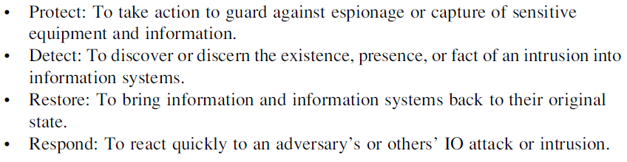
Cont…

Slide 7
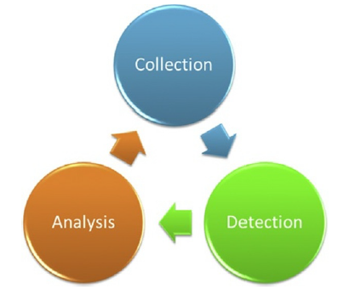
Characteristics of Network Security Monitoring
Prevention eventually fails: A motivated attacker will always find his way in.
Focus on Collection: Collecting all data is cost ineffective. You must have data to parse. It should be able to perform the same level of detection with less data.
Cyclical process: IID is not a linear process (alert, validate, and respond). Attackers have become slow and methodical. Cyclical processes act based on:
Threat-Centric Defense: Focuses on who performs the attack (Threat Actor) and why (Motivation). Requires extensive visibility into the network, collect data, and analyze it.

Slide 8
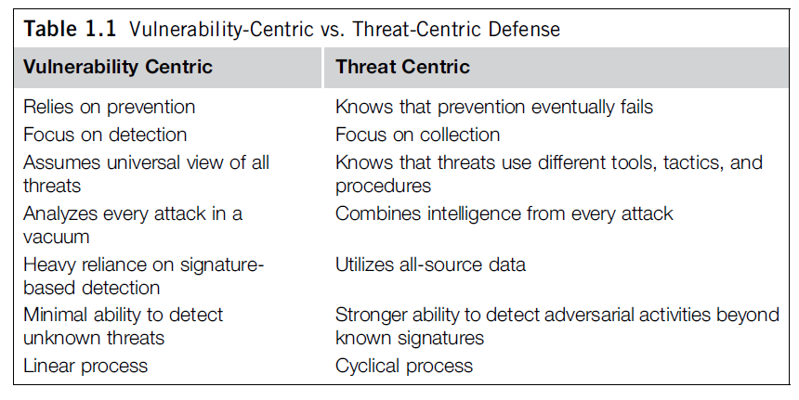
VULNERABILITY-CENTRIC VS. THREAT-CENTRIC DEFENSE

Slide 9
Collection
Collection occurs with a combination of hardware and software that are used to generate, organize, and store data for NSM detection and analysis.
CAREFUL! Trash in → Trash out
Data categories: Full Content Data, Session Data, Statistical
Data, Packet String Data, and Alert Data.
Effective collection requires a concerted effort from organizational leadership, the information security team, and network and systems administration groups.

Slide 10
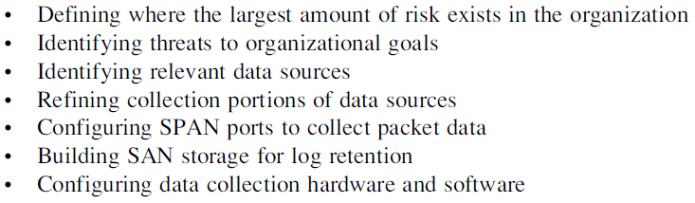
Collection Tasks

Slide 11
Detection
Collected data is examined and alerts are generated based upon observed events and data that are unexpected.
Network Intrusion Detection Systems (NIDS)
Snort IDS
Bro IDS → Zeek
Host Based Intrusion Detection Systems (HIDS)
OSSEC
AIDE
McAfee HIPS
Security Information and Event Management (SIEM) applications
Elastic SIEM
Make use of NIDS and HIDS to do detection

Slide 12
Analysis
Interpretation of Collected Data and Interpretation
Investigate other data sources
Ways analysis can be performed:
Packet analysis
Network forensics
Host forensics
Malware analysis

Slide 13
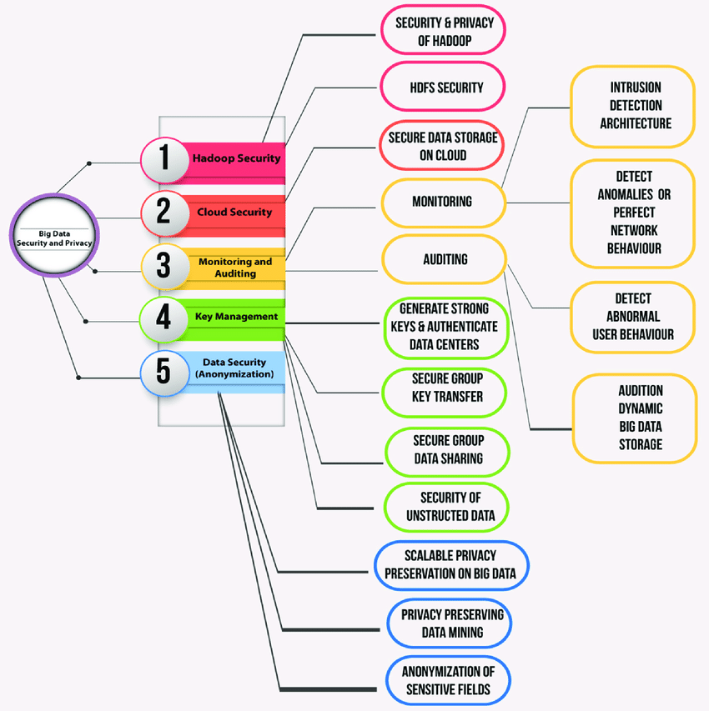
Big Data Security

Slide 14
Challenges to NSM
NSM is still immature science exiting within another immature science (Information Technology)
Disparity in protocols (Written vs Applied)
NSM lacks regulation: group of practitioners that often speak on different wavelengths.

Slide 15
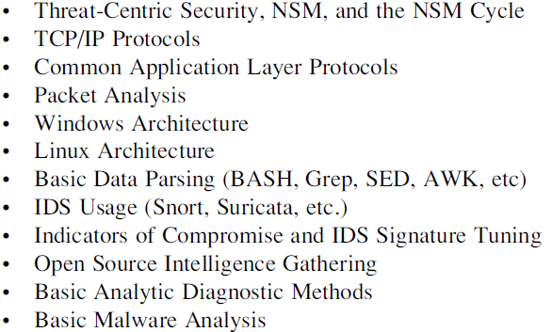
The Analyst – Baseline Skills

Slide 16
Specializations – Offensive Tactics
Attempt to gain access to attack the network in the same way an adversary would.
Penetration testing
Security Assessment
Network reconnaissance, software and service exploitation, backdoors, malware usage, and data exfiltration techniques.

Slide 17
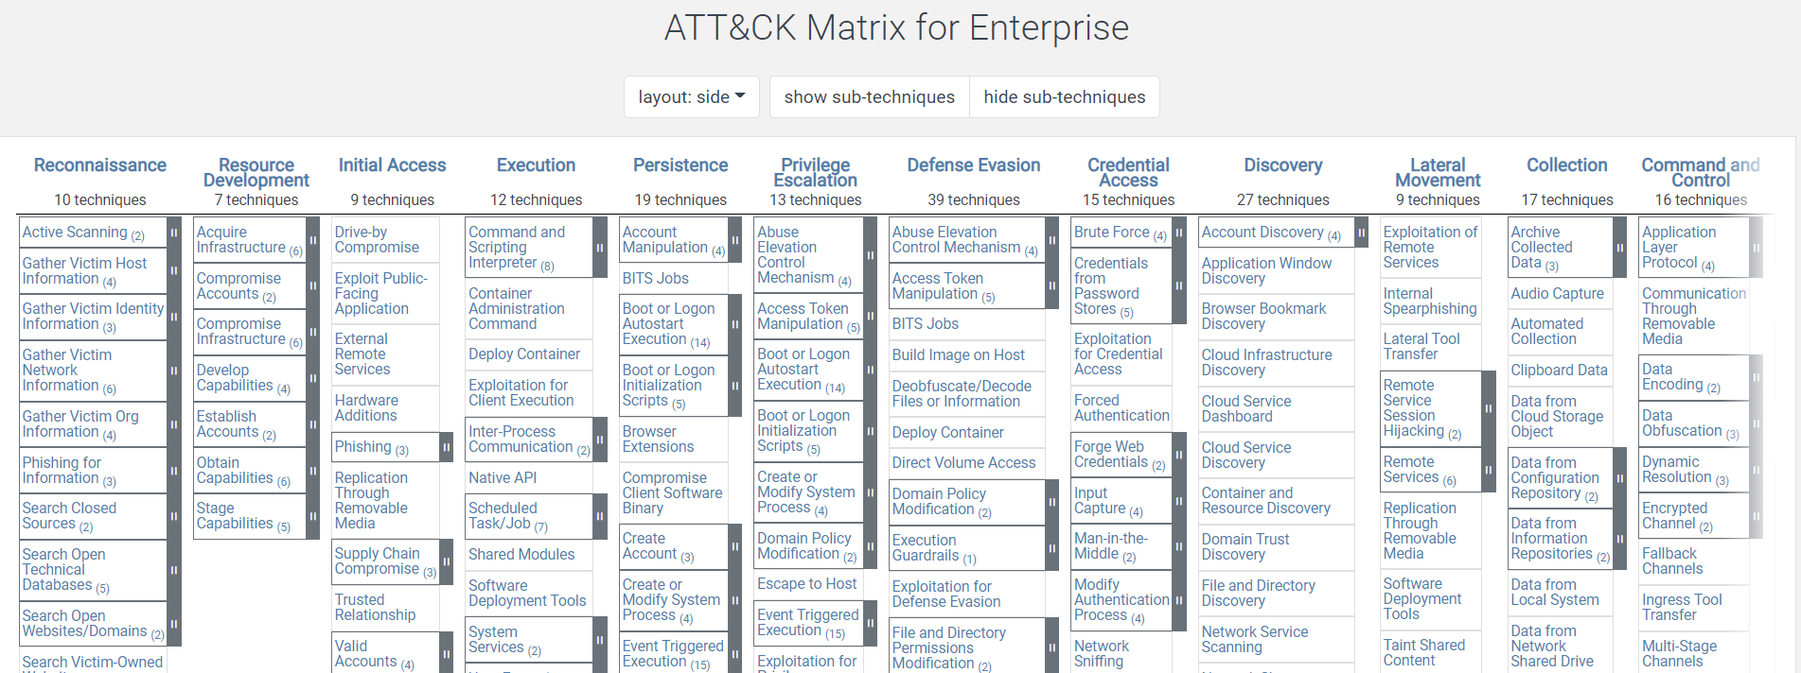
Mitre – Cyber Kill Chain

Slide 18
Specializations – Defensive Tactics
Master of detection and analysis
Conceptualizing new development tools and analytic methods.
New tools and research related to network defense, and to evaluate those tools for use within the organization’s NSM program.
Detailed knowledge of network communications,

Slide 19
Specializations - Programming
Develop custom detection and analysis solutions for an NSM team
Expert in parsing datasets
Very strong understanding of the Linux BASH environment
Literate in Python, PERL, C++, Java

Slide 20
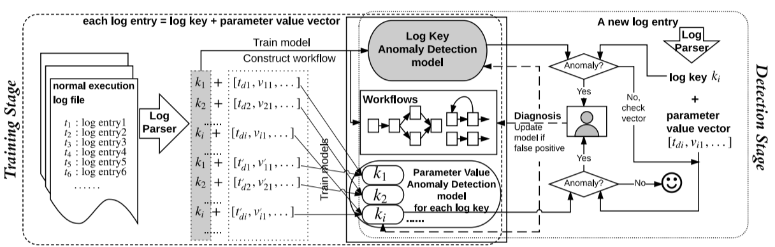
Specializations - Programming
Host-Based IDS
Du, Min, et al. "Deeplog: Anomaly detection and diagnosis from system logs through deep learning." Proceedings of the 2017 ACM SIGSAC Conference on Computer and Communications Security. 2017.

Slide 21
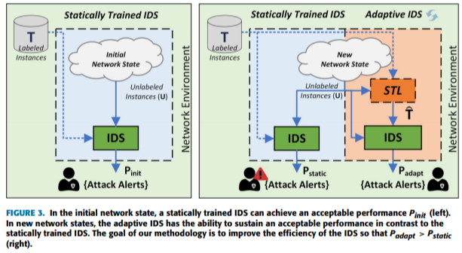
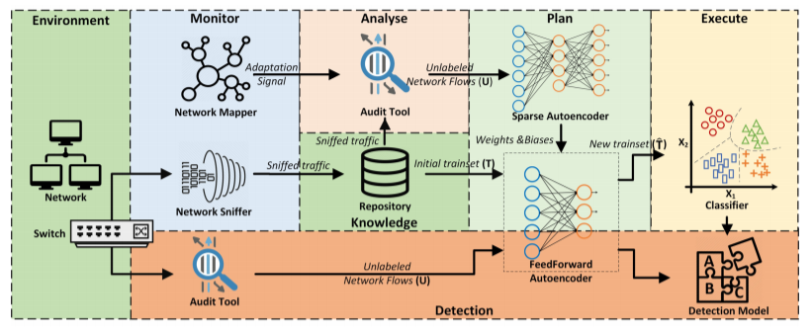
Specializations - Programming
Network-Based IDS
Papamartzivanos, Dimitrios, Félix Gómez Mármol, and Georgios Kambourakis. "Introducing deep learning self-adaptive misuse network intrusion detection systems." IEEE Access 7 (2019): 13546-13560.

Slide 22
Specializations - Programming
Heavily involved with collection processes such as configuring IDS and moving data around so that it may be properly ingested by various detection software packages
An in-depth knowledge of both
Windows and Linux platforms is the basis for the specialization, along with an adept
understanding of data and log collection

Slide 23
Specializations – Malware Analyst
Basic malware sandboxing in order to extract indicators
High level of malware analysis: knowledge of both dynamic and static analysis.

Slide 24
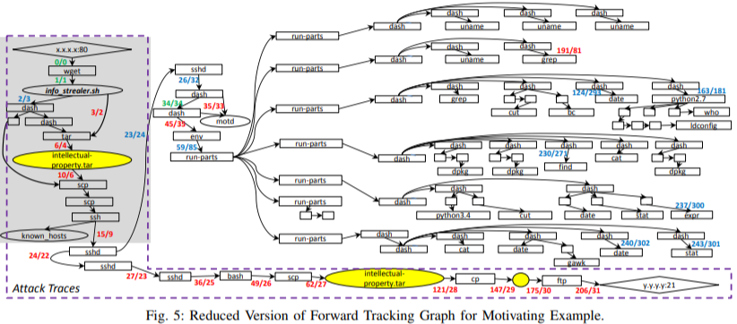
Specializations – Host-Based Forensics
Gains intelligence from an asset that has been compromised by doing a forensic analysis of the host.

Slide 25
Before Next Class
Create a Security Onion VM using Virtual Box and Vagrant
Page 19 in your book and tutorials

